Slide 1


Machine Learning Basics
张江
北京师范大学系统科学学院教授
集智俱乐部、集智学园创始人
集智研究中心理事长
更多“人工智能 & 复杂系统”的知识，请关注官网：campus.swarma.org
Notes:
封面

Slide 2
Outline
Background and Classification
Regression
Binary Classification
更多“人工智能 & 复杂系统”的知识，请关注官网：campus.swarma.org

Slide 3
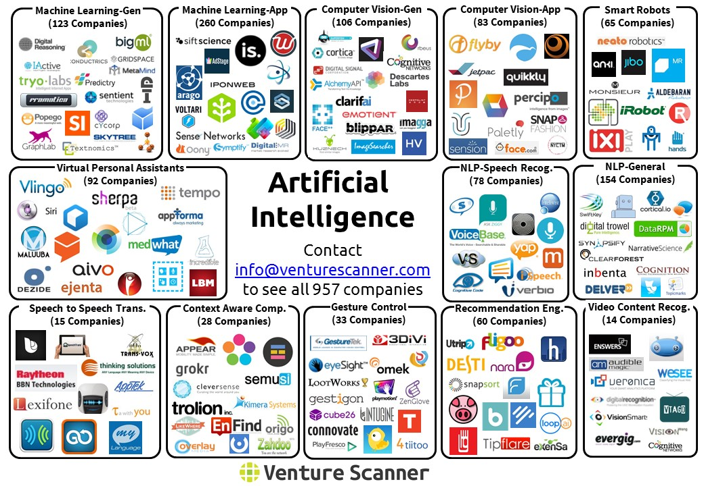

Slide 4
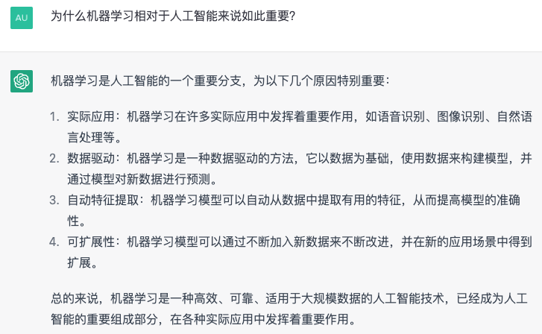
为什么机器学习如此重要？
数据
可扩展性
鲁棒性/适应性
更多“人工智能 & 复杂系统”的知识，请关注官网：campus.swarma.org

Slide 5
What is Computation?
输入
给定输入，得到输出
1+1 → 2
256 * 211 →54016
1,2,4,2,1→1,1,2,2,4
…
如何运算的过程就是程序
1
2
5
10
100
X²-X
0
2
20
90
9900
输出
更多“人工智能 & 复杂系统”的知识，请关注官网：campus.swarma.org

Slide 6
What is Machine Learning?
Input
1
2
5
10
100
Inversion of computation
X²+1
2
5
26
101
10001
Output
更多“人工智能 & 复杂系统”的知识，请关注官网：campus.swarma.org

Slide 7
What is Machine Learning?
Machine Learning
Data of input-output pairs
Model
Machine Learning：Universal Programmer
更多“人工智能 & 复杂系统”的知识，请关注官网：campus.swarma.org

Slide 8
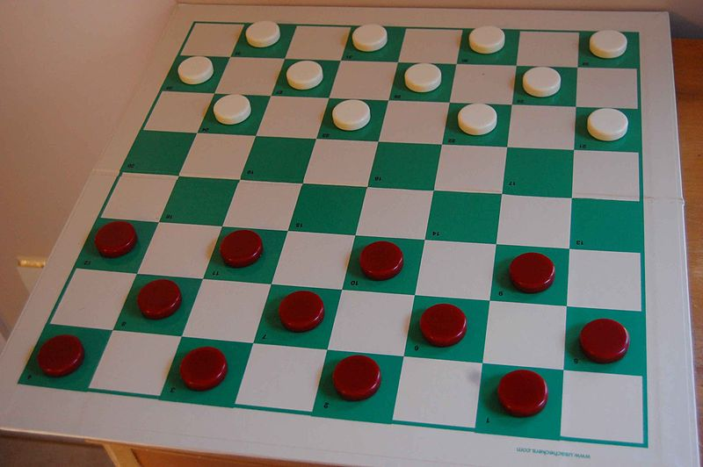
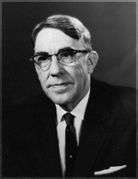
What is Machine Learning?
Arthur Samuel (1959): Machine learning: Field of study that gives computers the ability of learn without being explicitly programmed.
更多“人工智能 & 复杂系统”的知识，请关注官网：campus.swarma.org

Slide 9

What is Machine Learning?
Tom Mitchell (1988): Well-posed learning problem: a computer program is said to learn from experience E with respect to some task T and some performance measure P, if its performance on T, as measured by P, improves with experience E.
Tom Mitchell
更多“人工智能 & 复杂系统”的知识，请关注官网：campus.swarma.org

Slide 10
Classifications
更多“人工智能 & 复杂系统”的知识，请关注官网：campus.swarma.org

Slide 11
Classifications
Label/No Label
Classification
Classification
Yes
Regression
Regression
Transfer Learning
Feature Learning
Inference
Clustering
No
Human Computation
Reinforcement Learning
Deep Learning
Small
Big
更多“人工智能 & 复杂系统”的知识，请关注官网：campus.swarma.org

Slide 12
Outline
Background and Classification
Regression
Binary Classification
更多“人工智能 & 复杂系统”的知识，请关注官网：campus.swarma.org

Slide 13
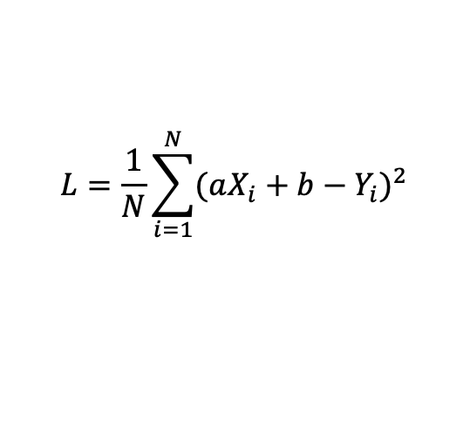
Linear Regression
Judgment: Error(Vertical distances between samples and the line)
Finding a best line (a,b) such that the Error could be minimized
This process is Training or learning
Price
y=a t+b
Minimize:
To obtain a*,b*
$$L=\frac{1}{N}\sum_{i=1}^{N}{{(aX_{i}+b−Y_{i})}^{2}}$$
2011 2012 2013 2014 2015 2016 2017 2018
Time
更多“人工智能 & 复杂系统”的知识，请关注官网：campus.swarma.org

Slide 14
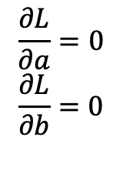
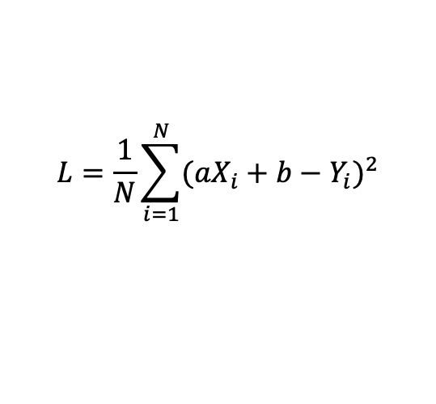
Linear Regression
Price
y=a t+b
Minimize:
To obtain a*,b*
By solving:
$$L=\frac{1}{N}\sum_{i=1}^{N}{{(aX_{i}+b−Y_{i})}^{2}}$$
$$\frac{∂L}{∂a}=0$$
$$\frac{∂L}{∂b}=0$$
2011 2012 2013 2014 2015 2016 2017 2018
Time
更多“人工智能 & 复杂系统”的知识，请关注官网：campus.swarma.org

Slide 15
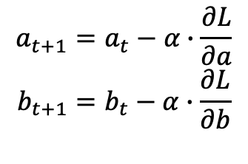
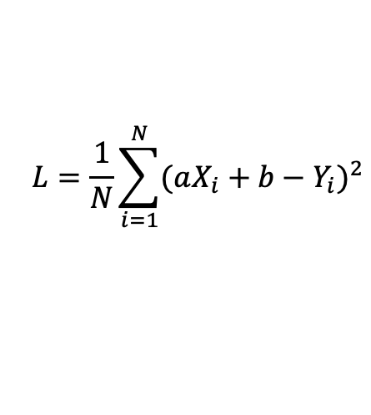
Gradient Descent Method
Minimize:
To obtain a*,b*
This is gradient descent algorithm:
$$L=\frac{1}{N}\sum_{i=1}^{N}{{(aX_{i}+b−Y_{i})}^{2}}$$
$$a_{t+1}=a_{t}−α∙\frac{∂L}{∂a}$$
$$b_{t+1}=b_{t}−α∙\frac{∂L}{∂b}$$
更多“人工智能 & 复杂系统”的知识，请关注官网：campus.swarma.org

Slide 16
Test
Price
y=a t+b
After obtaining a*,b*, we insert t=2018 into y=a t+b to obtain the corresponding y^
Time
2011 2012 2013 2014 2015 2016 2017 2018
更多“人工智能 & 复杂系统”的知识，请关注官网：campus.swarma.org

Slide 17
Evaluation
Training data
Test data
To notice:
Similar distribution
Particular, same proportion for each label
Training : test
9:1~2:1
更多“人工智能 & 复杂系统”的知识，请关注官网：campus.swarma.org

Slide 18
Evaluation
Price
y=a t+b
Compare the predicted price with the real price in the test data set to calculate the accuracy
This process is called Testing
Time
2011 2012 2013 2014 2015 2016 2017 2018
更多“人工智能 & 复杂系统”的知识，请关注官网：campus.swarma.org

Slide 19
Important Conceptions
Training – learning
Testing
Sample
Model
Objective function
Learning algorithm
Parameter
Hyper-parameter
更多“人工智能 & 复杂系统”的知识，请关注官网：campus.swarma.org

Slide 20
More functions
Price
Y=A sin(a x+b)
？
Time
2011 2012 2013 2014 2015 2016 2017 2018
更多“人工智能 & 复杂系统”的知识，请关注官网：campus.swarma.org

Slide 21
More general
Model: z=f(t,d)
To predict…
更多“人工智能 & 复杂系统”的知识，请关注官网：campus.swarma.org

Slide 22
Underfitted & Overfitted
更多“人工智能 & 复杂系统”的知识，请关注官网：campus.swarma.org

Slide 23
No noise
https://arxiv.org/abs/1803.08823

Slide 24
Over
fitting
https://arxiv.org/abs/1803.08823

Slide 25
Get over over-fitting
Reduce the model
Add more data
https://arxiv.org/abs/1803.08823
更多“人工智能 & 复杂系统”的知识，请关注官网：campus.swarma.org

Slide 26
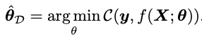
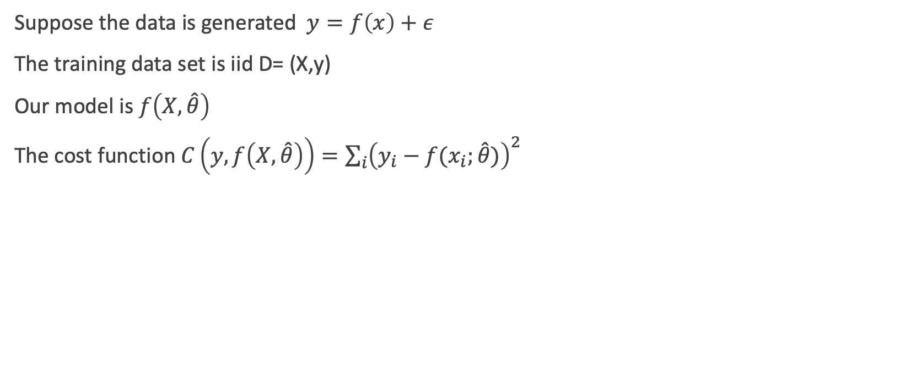
Bias variance decomposition
Suppose the data is generated $y=f\left(x\right)+ε$
The training data set is iid D= (X,y)
Our model is $f\left(X,\hat{θ}\right)$
The cost function $C\left(y,f\left(X,\hat{θ}\right)\right)=\sum_{i}{{\left(y_{i}−f(x_{i};\hat{θ})\right)}^{2}}$
Expectation on all possible data sets
https://arxiv.org/abs/1803.08823

Slide 27
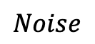
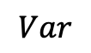
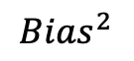
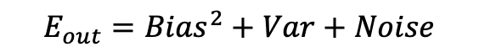
Bias variance decomposition
$$Noise$$
$$E_{out}={Bias}^{2}+Var+Noise$$
$${Bias}^{2}$$
$$Var$$
https://arxiv.org/abs/1803.08823

Slide 28
Bias variance trade-off
https://arxiv.org/abs/1803.08823
更多“人工智能 & 复杂系统”的知识，请关注官网：campus.swarma.org

Slide 29
Bias variance trade-off
https://arxiv.org/abs/1803.08823
更多“人工智能 & 复杂系统”的知识，请关注官网：campus.swarma.org

Slide 30
Summary
Underfitting
Overfitting
Noise
Bias
Variance
Bias-variance trade of
Model complexity
更多“人工智能 & 复杂系统”的知识，请关注官网：campus.swarma.org

Slide 31
Outline
Background and Classification
Regression
Binary Classification
更多“人工智能 & 复杂系统”的知识，请关注官网：campus.swarma.org

Slide 32
Classification Problem
Feature
肿瘤尺寸(cm) | 良性／恶性
1.4 | 0
2.0 | 1
1.0 | 1
0.5 | 0
1.5 | ?
0.2 | 0
2.5 | 1
Label (Decision variable)
更多“人工智能 & 复杂系统”的知识，请关注官网：campus.swarma.org

Slide 33
Classification → Regression?
Class
1
？
0
Size
更多“人工智能 & 复杂系统”的知识，请关注官网：campus.swarma.org

Slide 34
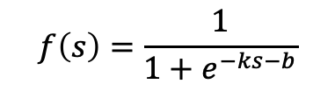
Classification → Regression?
Class
$$f\left(s\right)=\frac{1}{1+e^{−ks−b}}$$
1
？
？
Logistic function, value is belong to [0,1], can be explained as the Prob of class 1
0
Size
更多“人工智能 & 复杂系统”的知识，请关注官网：campus.swarma.org

Slide 35
Two Dimensional
Feature
Decision
年龄 | 肿瘤尺寸(cm) | 良性／恶性
40 | 1.4 | 0
58 | 2.0 | 1
43 | 1.0 | 1
24 | 0.5 | 0
70 | 1.5 | ?
64 | 0.2 | 0
35 | 2.5 | 1
Labels
更多“人工智能 & 复杂系统”的知识，请关注官网：campus.swarma.org

Slide 36

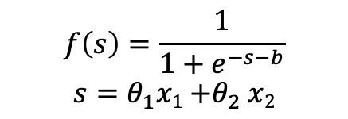
Classification
$$f\left(s\right)=\frac{1}{1+e^{−s−b}}$$
$$s=θ_{1}x1{+θ}_{2}x2$$
年龄
尺寸
$$f\left(s\right)=1/2$$
更多“人工智能 & 复杂系统”的知识，请关注官网：campus.swarma.org

Slide 37
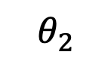
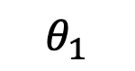

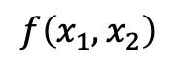
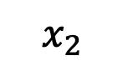

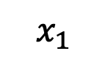
$$f\left(s\right)=\frac{1}{1+e^{−s−b}}$$
$$s=θ_{1}x1{+θ}_{2}x2$$
Classification
$$x_{1}$$
$$θ_{1}$$
$$f\left(x_{1},x_{2}\right)$$
$$θ_{2}$$
$$x_{2}$$
年龄
尺寸
$$f\left(s\right)=1/2$$
更多“人工智能 & 复杂系统”的知识，请关注官网：campus.swarma.org

Slide 38
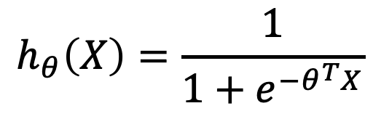
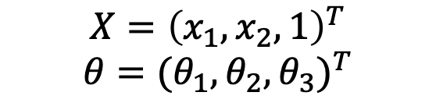

Mathematical Formulation
$$h_{θ}\left(X\right)=\frac{1}{1+e^{−θ^{T}X}}$$
年龄
$$X={\left(x_{1},x_{2},1\right)}^{T}$$
$$θ={(θ_{1},θ_{2},θ_{3})}^{T}$$
尺寸
$$f\left(s\right)=1/2$$
更多“人工智能 & 复杂系统”的知识，请关注官网：campus.swarma.org

Slide 39
Decision
For given parameters which will be learnt by learning algorithm θ
For given a sample X
The classification rule is:
y
1
0.5
0
s

Slide 40
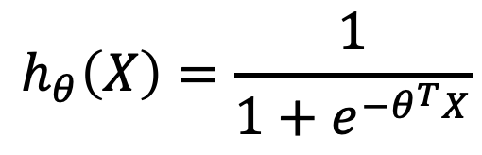
Mathematical Formulation
$$h_{θ}\left(X\right)=\frac{1}{1+e^{−θ^{T}X}}$$
h_{θ}(X) is explained as the probability Pr(y=+1|x;θ)
1-p(X) is the probability Pr(y=0|x; θ)
年龄
尺寸
$$f\left(s\right)=1/2$$
更多“人工智能 & 复杂系统”的知识，请关注官网：campus.swarma.org

Slide 41
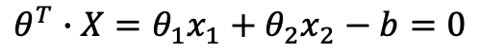
Classification
Age x₂
Decision curve
$$θ^{T}∙X=θ_{1}x_{1}+θ_{2}x_{2}−b=0$$
Labeled data
Tumor size x₁

Slide 42
Loss function
Intuitively, we have the following cost function
However, it is not convex, so we adopt

Slide 43
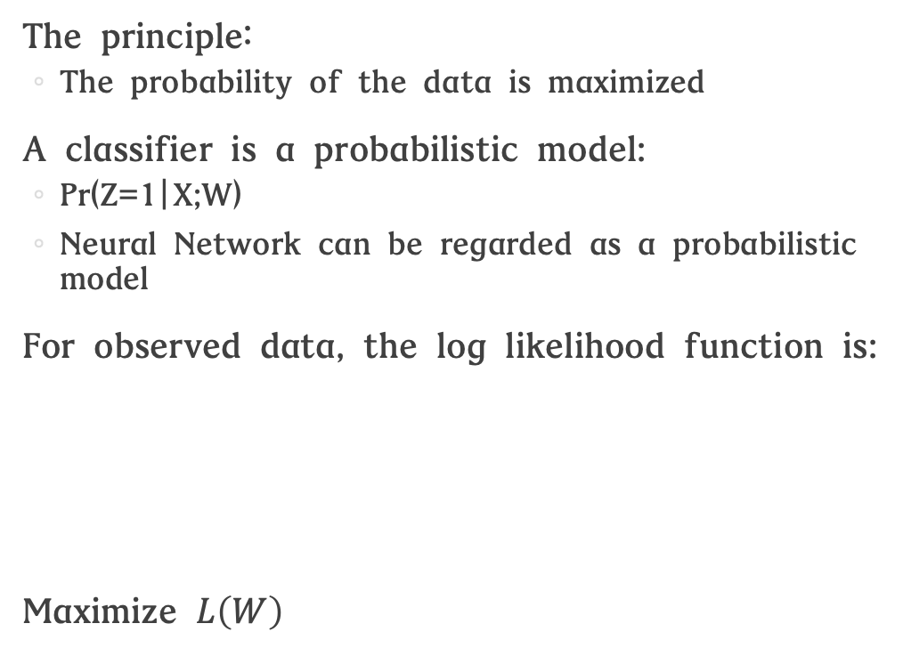
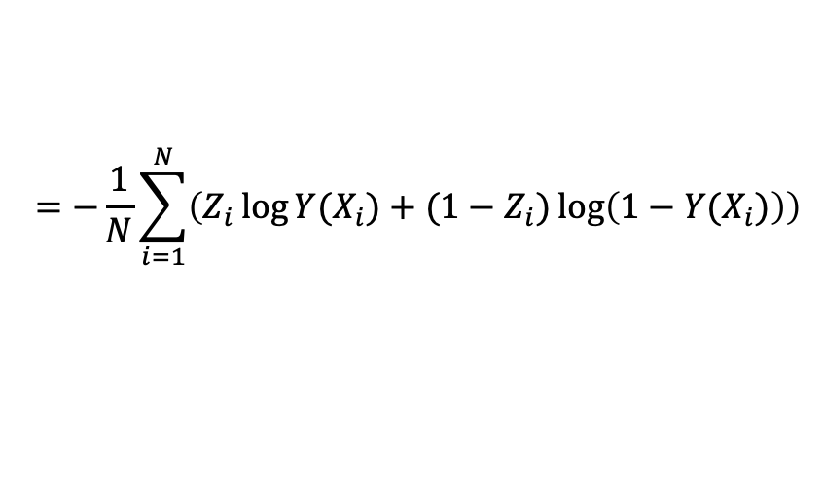
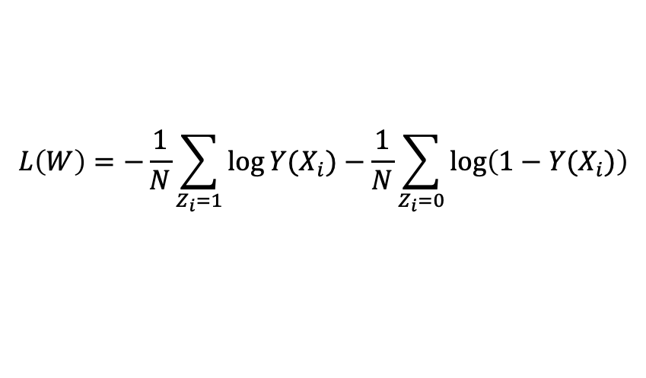
Log likelihood
The principle：
The probability of the data is maximized
A classifier is a probabilistic model:
Pr(Z=1|X;W)
Neural Network can be regarded as a probabilistic model
For observed data, the log likelihood function is:
Maximize $L\left(W\right)$
X1 | X2 | X3 | Z
0.1 | 2.1 | 0.4 | 1
0.3 | 1.1 | 2.1 | 0
…… | …… | …… | ……
$$L\left(W\right)=−\frac{1}{N}\sum_{Z_{i}=1}{\log{Y(X_{i})}}−\frac{1}{N}\sum_{Z_{i}=0}{\log\left(1−Y(X_{i})\right)}$$
$$=−\frac{1}{N}\sum_{i=1}^{N}{\left(Z_{i}\log{Y(X_{i})}+(1−Z_{i})\log\left(1−Y(X_{i})\right)\right)}$$

Slide 44
Gradient Descent
We use gradient descent algorithm to optimize the problem
In every time step(epoch):

Slide 45
Underfitted & Overfitted
更多“人工智能 & 复杂系统”的知识，请关注官网：campus.swarma.org

Slide 46
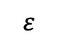
Stop Criterion
Loss function
$$ε$$
Epoch
更多“人工智能 & 复杂系统”的知识，请关注官网：campus.swarma.org

Slide 47
Data Preparation
Training data
Test data
Validation data
Validation data is used to adjusting hyper parameters to reduce over fitting
更多“人工智能 & 复杂系统”的知识，请关注官网：campus.swarma.org

Slide 48
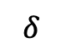
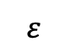
Stop Criterion
Objective function
Loss function
Costs for validation data
Costs for training data
$$ε$$
$$δ$$
Epoch
更多“人工智能 & 复杂系统”的知识，请关注官网：campus.swarma.org

Slide 49
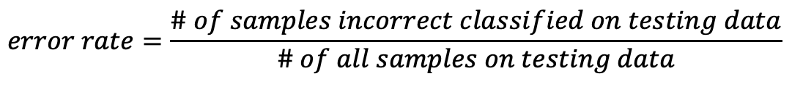
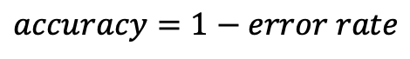
Evaluation
Training data
Testing data
$$error rate=\frac{\# of samples incorrect classified on testing data}{\# of all samples on testing data}$$
$$accuracy=1−error rate$$

Slide 50
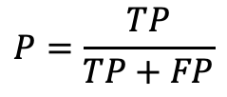
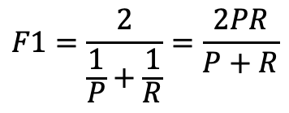
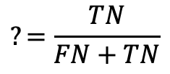
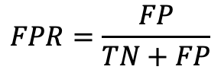
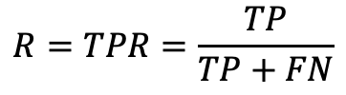
Confusion Matrix
Confusion matrix
Truth | Prediction
 | positive | negative
positive | TP(真正例) | FN(假反例)
negative | FP(假正例) | TN(真反例)
Recall （查全率）
$$R=TPR=\frac{TP}{TP+FN}$$
True positive rate真正例率
$$FPR=\frac{FP}{TN+FP}$$
False positive rate假正例率
$$P=\frac{TP}{TP+FP}$$
$$?=\frac{TN}{FN+TN}$$
$$F1=\frac{2}{\frac{1}{P}+\frac{1}{R}}=\frac{2PR}{P+R}$$
Precision （查准率）

Slide 51
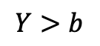
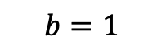
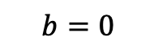
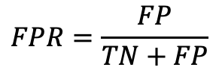
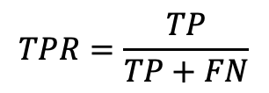
ROC/AUC
$$b=0$$
当我调节参数值（例如输出概率的阈值），会得到不同的TPR和FPR，从而得到ROC曲线以及AUC
$$Y>b$$
1
$$TPR=\frac{TP}{TP+FN}$$
随机
$$FPR=\frac{FP}{TN+FP}$$
$$b=1$$

Slide 52
K-folded cross validation
K=5 subsets
Testing
Experiment1
Training
Testing
Experiment2

Slide 53
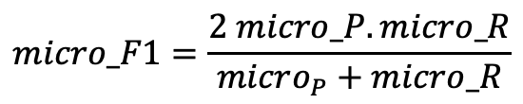
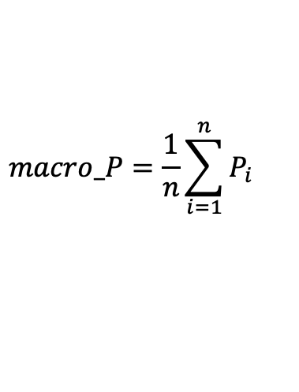
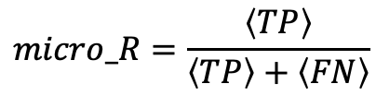
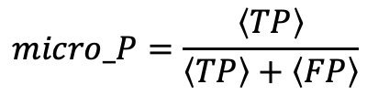
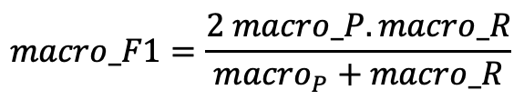
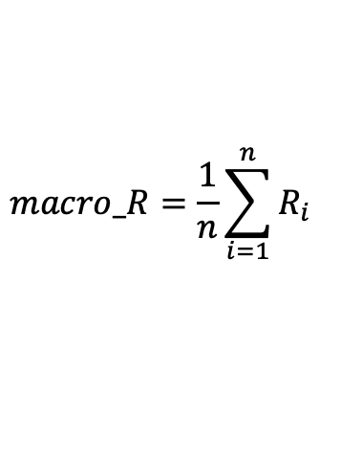
How to summarize
Suppose each experiment get a confusion matrix
$$macro_P=\frac{1}{n}\sum_{i=1}^{n}{P_{i}}$$
$$macro_R=\frac{1}{n}\sum_{i=1}^{n}{R_{i}}$$
$$macro_F1=\frac{2 macro_P. macro_R}{macro_{P}+macro_R}$$
$$micro_P=\frac{\left\langle TP\right\rangle }{\left\langle TP\right\rangle +\left\langle FP\right\rangle }$$
$$micro_R=\frac{\left\langle TP\right\rangle }{\left\langle TP\right\rangle +\left\langle FN\right\rangle }$$
$$micro_F1=\frac{2 micro_P. micro_R}{micro_{P}+micro_R}$$

Slide 54
Summary
What is machine learning
Definition
Classification
Regression
Linear Regression
Evaluation
Bias-variance trade off
Binary Classification
Logistic Regression
Evaluation
更多“人工智能 & 复杂系统”的知识，请关注官网：campus.swarma.org
Notes:
尾页

Slide 55
Exercise
Can you repeat the experiments of Page 24-26?
更多“人工智能 & 复杂系统”的知识，请关注官网：campus.swarma.org
Notes:
尾页

Slide 56
推荐一个神奇的网站
更多“人工智能 & 复杂系统”的知识，请关注官网：campus.swarma.org
Notes:
尾页

